Slide 1
Project Management and Planning
COMP6100001 - Software engineering
Session 11
Kenny Jingga, S.Kom., M.T.

Slide 2
Session 11 – Project Management and Planning
Learning objectives
At the end of this session, students will be expected to:
Understand the way of thinking in software engineering
Understand the fundamental software project management
Know how to be a good leader and lead the team in software project

Slide 3
Session 11 – Project Management and Planning
Content outline
Introduction to Project Management Concepts
Importance of Project Planning in Software Engineering
Roles & responsibilities
Work Breakdown Structure (WBS)

Slide 4
Introduction to Project Management Concepts
Definition and Principles of Project Management
Definition:
  Project Management is the application of knowledge, skills, tools, and techniques to project activities to meet the project requirements.
Key Principles:
  Project Initiation: Defining the project at a broad level.
  Project Planning: Establishing the scope, objectives, and procedures.
  Project Execution: Coordinating people and resources.
  Project Monitoring and Control: Tracking progress and performance.
  Project Closure: Formalizing acceptance and bringing the project to an orderly end.

Slide 5
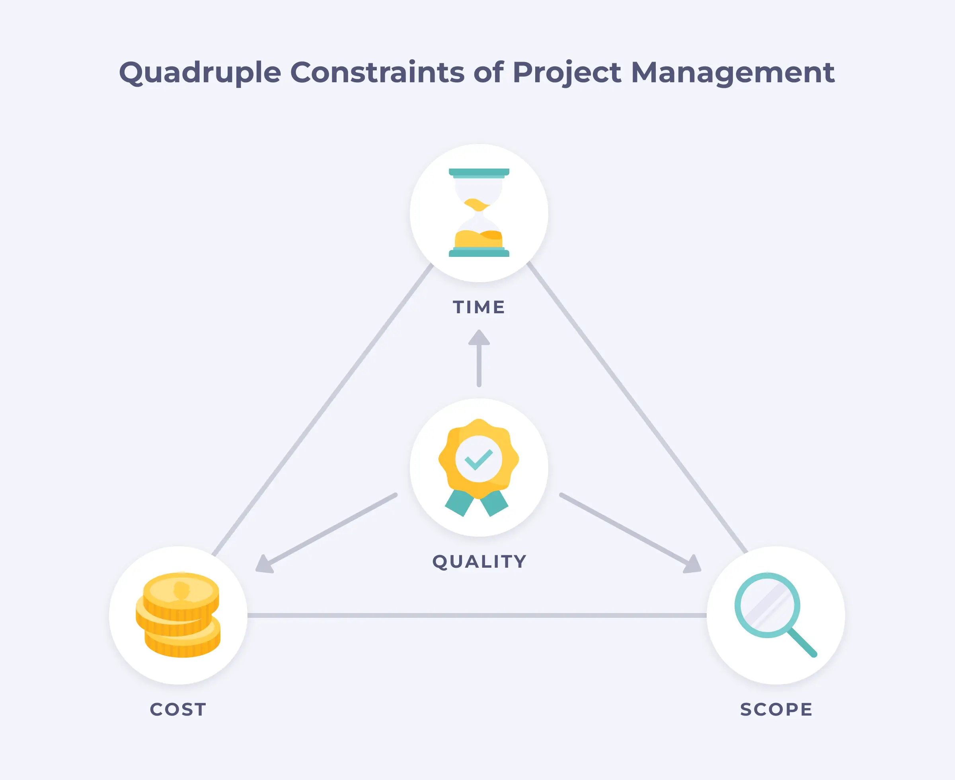
Introduction to Project Management Concepts
Project Constraints
Scope: Defines what is included in the project.
Time: The schedule for completion.
Cost: Budget allocated.
Quality: The standards and criteria to meet.

Slide 6
Introduction to Project Management Concepts
The Management Spectrum
Software project management is an essential part of software engineering
Effective software project management focuses on the four P’s:
  People
  Product
  Process
  Project

Slide 7
Introduction to Project Management Concepts
The Four P’s: People
The Stakeholders → participate in the software process and the way they are organized to perform effective software engineering:
  Senior managers (product owners) who define the business issues that often have a significant influence on the project
  Project (technical) managers (Scrum masters or team leads) who must plan, motivate, organize, and coordinate the practitioners who do software work.
  Practitioners who deliver the technical skills that are necessary to engineer a product or application.
  Customers who specify the requirements for the software to be engineered and other stakeholders who have a peripheral interest in the outcome.
  End users who interact with the software once it is released for production use.

Slide 8

Introduction to Project Management Concepts
People: Working solo vs as a Team

Slide 9
Introduction to Project Management Concepts
People: Working AS A Team
Design & Implement Software
  Establish a collaboration process
  Meet with the team
  Choose a leader
  Divide work and integrate
  Share knowledge
  Resolve conflicts

Slide 10
Introduction to Project Management Concepts
People: How To Lead A Team
Managers and Tech Leads (and Both)
Experienced manager comes in to run a team
An individual contributor is promoted into a leadership position (usually of a smaller team)
Both roles can be filled by the same person: a Tech Lead Manager (TLM)
On larger teams,
An experienced people manager will step in to take on the management role
A senior engineer with extensive experience will step into the tech lead role

Slide 11
Introduction to Project Management Concepts
The Engineering Manager
Software engineering managers should have an engineering background
An engineering manager is responsible for the performance, productivity, and happiness of every person on their team—including their tech lead—while still making sure that the needs of the business are met by the product for which they are responsible

Slide 12
Introduction to Project Management Concepts
The Tech Lead
The tech lead (TL) of a team → will often report to the manager of that team
Responsible for the technical aspects of the product, including technology decisions and choices, architecture, priorities, velocity, and general project management
Most TLs are also individual contributors, which are often forces to choose between doing something quickly themselves or delegating it to a team member to do (sometimes) more slowly
Delegation is most often the correct decision for the TL as they grow the size and capability of their team

Slide 13
Introduction to Project Management Concepts
The Tech Lead Manager
Tech Lead Manager (TLM) → a single person who can handle both the people and technical needs of their team
TLM must know how to balance individual work, delegation, and people management

Slide 14
Introduction to Project Management Concepts
Antipattern
Don’t follow these to be a successful manager:
  Hire Pushovers
  Ignore Low Performers
  Be Everyone’s Friend
  Compromise the Hiring Bar
  Treat Your Team Like Children
Why shouldn’t we do those patterns? Unleash your opinions!

Slide 15
Introduction to Project Management Concepts
Positive Pattern
Follow these to be a successful manager:
  Lose the Ego
  Be a Zen Master
  Be a Catalyst
  Remove Roadblocks
  Be a Teacher and a Mentor
  Set Clear Goals
  Be Honest
  Track Happiness
How are those patterns can help us to be a successful manager?

Slide 16
Introduction to Project Management Concepts
As A Leader
Delegate, but get your hands dirty
  Let the team know how skillful and dedicated (and humble) you are like jumping in and actually doing some hard work
Seek to replace yourself
  After you have team members capable of doing your job, you need to give them opportunities to take on more responsibilities or occasionally lead the team
Know when to make waves
  Waiting only delaying the inevitable and causing untold damage in the process. So, act and act quickly
Shield your team from chaos
  Outside your team is a world of chaos and uncertainty. Chaos has always been present, but manager must shield the team from it.
Give your team air cover
  Share as much information as possible with the team, but don’t distract team with organizational matters that is extremely unlikely to ever actually affect team
Let your team know when they’re doing well
  Provide positive feedback often enough
It’s easy to say “yes” to something that’s easy to undo
  Good leaders have a good sense for when something can be undone, but more things are undoable than you think (and this applies to both technical and nontechnical decisions).

Slide 17
Introduction to Project Management Concepts
Scale into a Good Leader
“The three Always of leadership”: Always Be Deciding, Always Be Leaving, Always Be Scaling
Always Be Deciding
  Managing a team of teams means making ever more decisions at ever-higher levels
  High-level strategy rather than how to solve any specific engineering task
  Finding the correct set of trade-offs.
Always Be Leaving
  Get the organization to solve problems by itself
  Build a “Self-Driving” Team
Always Be Scaling
  Most precious resource is limited pool of time, attention, and energy
  Work mostly on important things, rather than urgent things

Slide 18
Introduction to Project Management Concepts
Product
Examine the product and the problem it is intended to solve at the very beginning of the project
Software Scope → unambiguous and understandable at the management and technical levels
  Context → How does the software to be built fit into a larger system, product, or business context, and what constraints are imposed as a result of the context?
  Information objectives → What customer-visible data objects are produced as output from the software? What data objects are required for input?
  Function and performance → What function does the software perform to transform input data into output? Are any special performance characteristics to be addressed?

Slide 19
Introduction to Project Management Concepts
Product: Engineering for Equity
Software engineering → solve problems
Not only solve problems, build products that drive positive outcomes for the broadest base of people, including people who are the most difficult to reach
Consider how the tools you build will be leveraged to change the trajectory of humanity

Slide 20
Introduction to Project Management Concepts
Product: Bias is The Default
Fail to focus on users of different nationalities, ethnicities, races, genders, ages, socioeconomic statuses, abilities, and belief systems → inadvertently can fail users
Such failures are often unintentional
People have certain biases → most people exhibit unconscious bias, enforcing and promulgating existing stereotypes
Why is it a important thing to be realized? Look at the next case study

Slide 21
Introduction to Project Management Concepts
Case Study: Google Misses the Mark on Racial Inclusion
In 2015, software engineer Jacky Alcine pointed out that the image recognition algorithms in Google Photos were classifying his black friends as “gorillas.” Google was slow to respond to these mistakes and incomplete in addressing them.
What caused such a monumental failure? Several things:
  Image recognition algorithms depend on being supplied a “proper” (often meaning “complete”) dataset. The photo data fed into Google’s image recognition algorithm was clearly incomplete. In short, the data did not represent the population.
  Google itself (and the tech industry in general) did not (and does not) have much black representation, and that affects decisions subjective in the design of such algorithms and the collection of such datasets. The unconscious bias of the organization itself likely led to a more representative product being left on the table.
  Google’s target market for image recognition did not adequately include such underrepresented groups. Google’s tests did not catch these mistakes; as a result, the users did, which both embarrassed Google and harmed the users.
As late as 2018, Google still had not adequately addressed the underlying problem
As a result, the algorithm returned results that caused harm to our users
The harm to Google itself → reduced user trust and engagement with the company

Slide 22
Introduction to Project Management Concepts
Product: Understanding the Need for Diversity
Exceptional engineer → should bring diverse perspectives into product design and implementation
Have a computer science degree is insufficient for inclusive and equitable engineering
Focus all work within the framing of the complete ecosystem to be influenced
  At least → understand the population demographics of the users

Slide 23
Introduction to Project Management Concepts
Product: Building multicultural capacity
Exceptional engineer → able to understand how products can advantage and disadvantage different groups of human beings
Beside technical aptitude, it is important to have the discernment to know when to build something and when not to
Discernment includes building the capacity to identify and reject features or products that drive adverse outcomes

Slide 24
Introduction to Project Management Concepts
Product: Making diversity Actionable
Systemic equity and fairness are attainable → willing to accept that:
  We are accountable for the systemic discrimination we see in the technology sector
  We are accountable for the failures in the system
Technology lead or software engineering manager has the means to augment equity on their teams

Slide 25
Introduction to Project Management Concepts
Product: Reject Singular Approaches
Perpetuate solutions that present a single philosophy or methodology for fixing inequity in the technology sector is not enough
Problems are complex and multifactorial
Design from the start and raising development standards for development in order to make software delightful and accessible for people who struggle to access technology can enhance the experience for all users
Best practice → designing for the user who is least like you

Slide 26
Introduction to Project Management Concepts
Process
A generic process framework for software engineering encompasses five activities:
  Communication
  Planning
  Modeling
  Construction
  Deployment
Decide which process model is most appropriate for:
  The customers who have requested the product and the people who will do the work
  The characteristics of the product
  The project environment in which the software team works

Slide 27
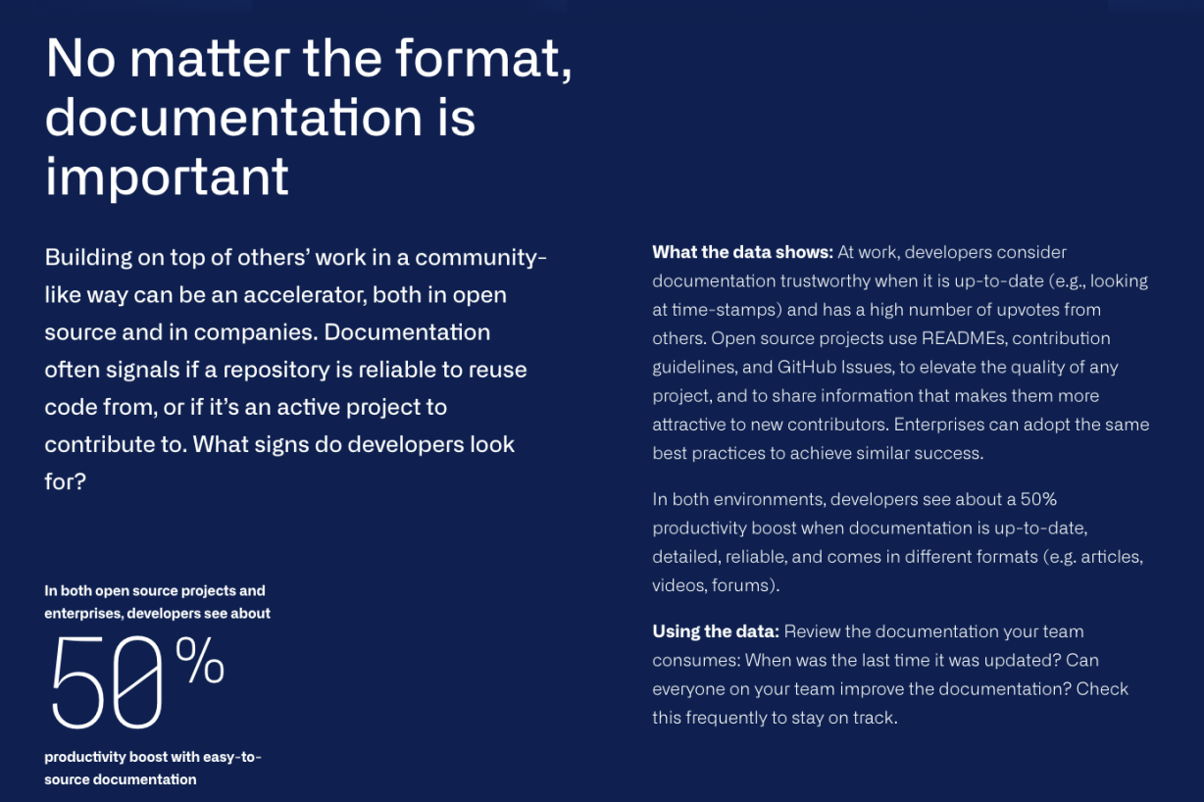
Introduction to Project Management Concepts
Process: Knowledge Sharing

Slide 28
Introduction to Project Management Concepts
Process: Know your audience
Internal document for your team (e.g., meeting note)
Documentation for project contributors
Documentation for non-developer collaborators (e.g., UX researchers)
Documentation for developer users
Documentation for clients with no software knowledge
User manual for end users

Slide 29
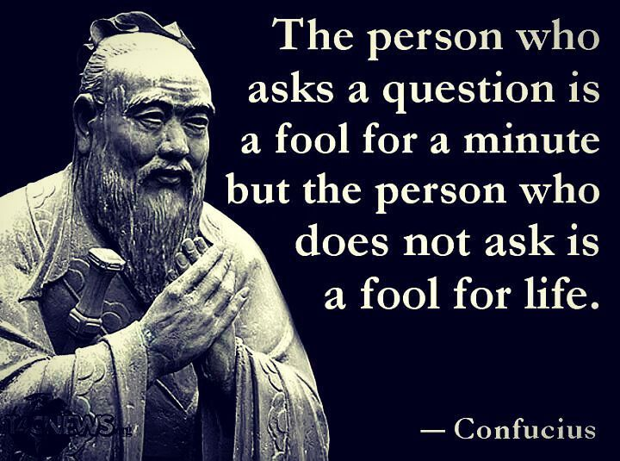
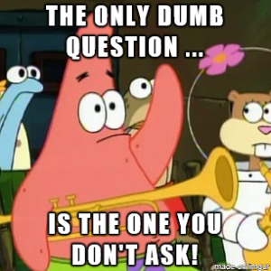
Introduction to Project Management Concepts
Process: Ask the questions

Slide 30
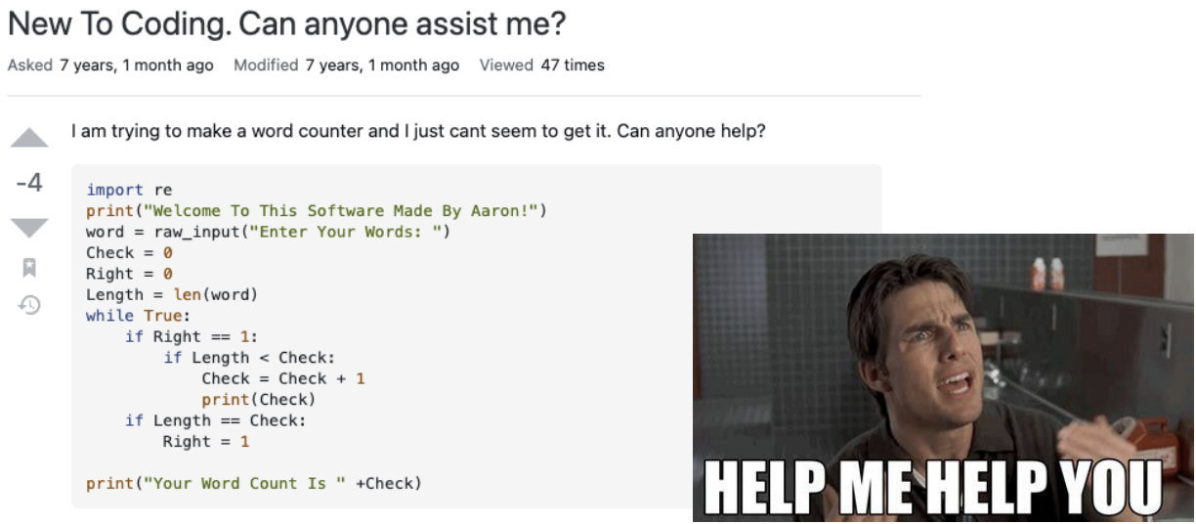
Introduction to Project Management Concepts
Process: What is wrong with this question?

Slide 31
Introduction to Project Management Concepts
Process: Make it easy for people to help you
I am trying to ____, so that I can ____.
I am running into ____.
I have looked at ____ and tried ____.
+ I’m using this tech stack: ____.
+ I’m getting this error/result: ____.
+ I think the problem could be ____.
Avoid Duplication!

Slide 32
Introduction to Project Management Concepts
Process: Communication and conflict resolution
You can’t solve any problem without communication!
Conflict Resolution
Your goal: Find a solution to the problem and move forward.
  As a smart person on “Ted Lasso” once said, “Fight forward, not back.”
Make sure everybody works from the same set of facts.
Establish ground rules for your team’s discussion.
  Talk about how the situation made you feel. Never presume anything about anyone else.
Remain calm and rational. If you feel triggered or threatened, extract yourself from the situation, wait an hour to chill out, and then try again.
If you reach an impasse, talk to your team leader.
If your team remains in conflict, escalate to your mentor.
  Your mentor will not solve your problem. They will help you to solve your own problems.

Slide 33
Introduction to Project Management Concepts
Project
To manage a successful software project → understand what can go wrong so that problems can be avoided
  Understand customer’s needs
  Changes are managed well, includes chosen technology change or shifted business needs and sponsorship management
  Realistic deadlines
  End users are ready to accept new system
  Have the requisite skills
  Learn from mistakes

Slide 34
Introduction to Project Management Concepts
Project: The W5HH Principle
An approach that addresses project objectives, milestones and schedules, responsibilities, management and technical approaches, and required resources
  Why is the system being developed? Assess the validity of business reasons for the software work
  What will be done? Task set required for the project is defined
  When will it be done? Establish a project schedule by identifying when project tasks are to be conducted and when milestones are to be reached
  Who is responsible for a function? The role and responsibility of each member of the software team is defined
  Where are they located organizationally? Not only software practitioners, the customer, users, and other stakeholders also have responsibilities.
  How will the job be done technically and managerially? Once product scope is established, a management and technical strategy for the project must be defined.
  How much of each resource is needed? Developing estimates based on answers to earlier questions

Slide 35

Plans are nothing, planning is everything
- Dwight D. Eisenhower

Slide 36
Importance of Project Planning in Software Engineering
Software Project Planning
The overall goal of project planning is to establish a pragmatic strategy for controlling, tracking, and monitoring a complex technical project.
Why?
So the end result gets done on time, with quality!

Slide 37
Importance of Project Planning in Software Engineering
Project Planning
Objectives:
Define Scope and Objectives: Clearly outline what needs to be achieved.
Resource Allocation: Determine necessary resources.
Risk Management: Identify potential risks and mitigation strategies.
Communication Plan: Establish how information will be shared.
Schedule Development: Create timelines and milestones.
Consequences of Poor Planning
Cost Overruns
Missed Deadlines
Scope Creep
Reduced Quality
Team Burnout

Slide 38
Work Breakdown Structure (WBS)
Definition and Purpose
WBS is a hierarchical decomposition of the total scope of work to be carried out by the project team.
Purpose:
Organize work into manageable sections.
Facilitate resource allocation, assignment of responsibilities, and measurement of progress.

Slide 39
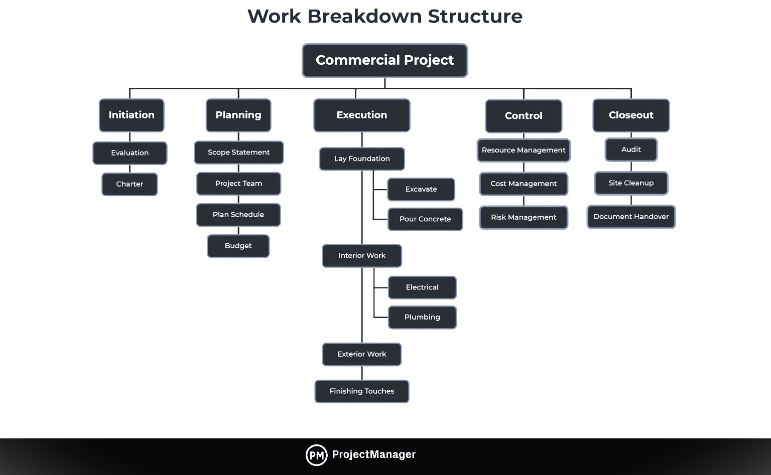
Work Breakdown Structure (WBS)
Steps to Create A WBS
Identify Major Deliverables: Start with the end products or services.
Decompose Deliverables: Break down into smaller, manageable components.
Assign Identification Codes: For tracking purposes.
Verify Decomposition: Ensure completeness and correctness.

Slide 40
References
Titus Winters, Tom Manshreck, and Hyrum Wright. (2020). Software Engineering at Google: Lesson Learned from Programming Over Time. 1st. O’Reilly Media. California. ISBN: 978-1492082798. Page 69-122.
Roger Pressman and Bruce Maxim. (2020). Software Engineering: A Practitioner's Approach. 9th. McGraw Hill. New York. ISBN: 978-1259872976. Chapter 24.
Ian Sommerville. (2016). Software Engineering. 10th. Pearson. London. ISBN: 978-1-292-09613-1. Chapter 22.
Boehm, B. W. (2020). Software Engineering Economics (4th Edition). Prentice Hall.
Project Management Institute. (2021). A Guide to the Project Management Body of Knowledge (PMBOK Guide) (7th Edition). Project Management Institute

